Slide 1
hporvrs
GOOGLE CLASSROOM CODE

Slide 2
TEXT BOOKS
Discrete Mathematics and its Applications, 7th Edition by K. Rosen, McGraw Hill
Discrete Mathematics with Applications, 5th Edition by Susanna S. Epp Gagne
Discrete Mathematics, Schaum's outlines, 4th edition

Slide 3
The Foundations: Logic and Proofs

Slide 4
BASIC
In computer every data is stored as binary representation
Starting from a number to English sentence
Convert (23)₁₀ in to Binary representation
2
23
2
11
1
2
5
1
Binary is: 10111
2
2
1
2
1
0
0
1

Slide 5
BASIC
Convert (23)₁₀ in to Binary representation
32
16
8
4
2
1
0
1
1
1
1
1
Convert (38)₁₀ in to Binary representation
32
16
8
4
2
1
1
0
0
1
1
0
Convert (110010)₂ in to Decimal representation
32
16
8
4
2
1
1
1
0
0
1
0
32 + 16 + 2 = 50

Slide 6
BASIC
Find the minimum and maximum numbers of 3 bit binary.
4
2
1
Minimum:
0
0
0
Decimal: 0
Maximum:
1
1
1
Decimal: 7
Find the minimum and maximum numbers of 4 bit binary.
8
4
2
1
Minimum:
0
0
0
0
Decimal: 0
Maximum:
1
1
1
1
Decimal: 15

Slide 7
BASIC
Find the total binary numbers that can be represented by 3 bits.
4
2
1
So total combination: 2 x 2 x 2 = 2³ = 8
2
2
2
How many numbers can be placed in this position?
2 numbers : 0/1
How many numbers can be placed in this position?
2 numbers : 0/1
How many numbers can be placed in this position?
2 numbers : 0/1
What are the numbers?
0 to 7
Find the total binary numbers that can represented by n bits.
Total numbers: 2^{n}
Numbers are from 0 to 2^{n} - 1

Slide 8
BASIC
Write down all the binary numbers consisted of 3 bits.
4
2
1
Decimal 0:
0
0
0
Decimal 1:
0
0
1
Decimal 2:
0
1
0
Decimal 3:
0
1
1
Decimal 4:
1
0
0
Decimal 5:
1
0
1
Decimal 6:
1
1
0
Decimal 7:
1
1
1

Slide 9
BASIC
Write down all the binary numbers consisted of 3 bits.
0
1
0
0
1
1
0
1
00
01
10
11
0
1
0
1
0
1
0
1
000
001
010
011
100
101
110
111
0
1
2
3
4
5
6
7

Slide 10
PROPOSITIONAL LOGIC

Slide 11
PROPOSITION
A declarative sentence
(Declares a fact)
The fact is either True or False
Example of proposition:
Dhaka is the capital of Bangladesh
(True)
1 + 1 = 3
(False)
Example of sentences that are not proposition:
What is your hobby?
(Not declarative sentence)
Read this book carefully
(Not declarative sentence)
x + 1 = 5
(Neither true, Neither false)

Slide 12
PROPOSITION REPRESENTATION
Proposition is denoted by a letter
p: Dhaka is the capital of Bangladesh
Here p is a proposition or a propositional variable
Representation of Truth value
T: True
F: False
In the above example: p ≡ T

Slide 13
LOGICAL OPERATIONS
To form compound proposition
Lets say, Today is Sunday. Then which of the propositions are true?
p: Today is Sunday
p
q: It is raining
Lets say, It is raining. Then which of the propositions are true?
r: Today is Sunday and it is raining
q
Lets say, Today is Monday. Then which of the propositions are false?
Lets say, Today is Sunday and also it is raining. Then which of the propositions are true?
p
r
Lets say, It is not raining. Then which of the propositions are false?
p
q
r
It implies that, r is true when both p and q are true. So, r is a combination of p and q
q
r

Slide 14





LOGICAL OPERATIONS
Let p and q are two propositions
Operation
Operator
Example
_
Negation
ㄱ
or
ㄱp
or
$$\overline{p}$$
Conjunction (AND)
^
p ^ q
Disjunction (Inclusive OR)
v
p ^{v} q
Exclusive OR (XOR)
$$⊕$$
p $⊕$ q
Implication
$$→$$
p $→$ q
Biconditional
↔
p ↔ q
Implication and Biconditional indicate conditional statements

Slide 15
NEGATION
Consider the following statement
p: Today is Sunday
ㄱp is True if Today is not Sunday
How to read
It is not the case that p
Simple expression
Find the negation of p
ㄱp: It is not the case that today is Sunday
ㄱp: Today is not Sunday

Slide 16
NEGATION
p: The Sun rises in the East
Find the negation of p
ㄱp: The Sun does not rise in the East
ㄱp: It is not the case that the Sun rises in the East
p: Rizu has at least two thousand taka in his money bag
Find the negation of p
ㄱp: Rizu does not have at least two thousand taka in his money bag
ㄱp: Rizu has less than two thousand taka in his money bag
ㄱp: It is not the case that Rizu has at least two thousand taka in his money bag

Slide 17
NEGATION
Truth Table
p | ㄱp
0 | 1
1 | 0
p | ㄱp
F | T
T | F

Slide 18
CONJUNCTION (AND)
Consider the following statements
p: Today is Sunday
q: It is raining today
p ^ q is true if both p and q are true
How to read
p and q
p but q (If p and q implies the contradictory meaning to each other)
Find the conjunction of p and q
Today is Sunday and it is raining today

Slide 19
CONJUNCTION (AND)
p: Today the sky is sunny
q: It is raining today
Find the conjunction of p
p ^ q : Today the sky is sunny and it is raining today
p ^ q : Today the sky is sunny but it is raining today

Slide 20
CONJUNCTION (AND)
Truth Table
p | q | p ^ q
p | q | p ^ q
0
0
0
F
F
F
0
1
0
F
T
F
1
0
0
T
F
F
1
1
1
T
T
T

Slide 21
DISJUNCTION (OR)
Consider the following statements
p: The light turns on by the main switch
q: The light turns on by the bed switch
p ^{v} q is true if any one between p and q is true
How to read
p or q
Find the disjunction of p and q
The light turns on by the main switch or the light turns on by the bed switch

Slide 22
DISJUNCTION (OR)
Truth Table
p | q | p ^{v} q
p | q | p ^{v} q
0
0
0
F
F
F
0
1
1
F
T
T
1
0
1
T
F
T
1
1
1
T
T
T

Slide 23
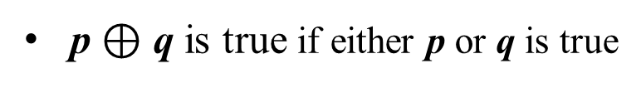
EXCLUSIVE OR (XOR)
Consider the following statements
p: Sheikh Hasina is the PM of Bangladesh
q: Khaleda Zia is the PM of Bangladesh
p $⊕$ q is true if either p or q is true
How to read
Either p or q
p or q but not both
Find the disjunction of p and q
Either Sheikh Hasina or Khaleda Zia is the PM of Bangladesh
Sheikh Hasina or Khaleda Zia but not both is the PM of Bangladesh

Slide 24
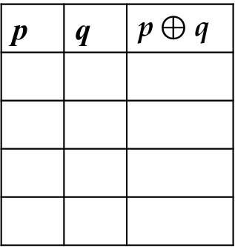
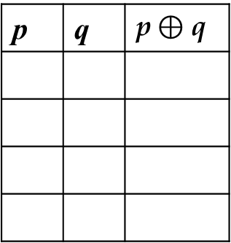
EXCLUSIVE OR (XOR)
Truth Table
p | q | p$⊕$ q
p | q | p$⊕$ q
0
0
0
F
F
F
0
1
1
F
T
T
1
0
1
T
F
T
1
1
0
T
T
F

Slide 25
IMPLICATION
Consider the following two propositions
p: Bangladesh plays at Mirpur
q: Bangladesh wins
p $→$ q implies a conditional statement: If p, then q.
If Bangladesh plays at Mirpur, then Bangladesh wins.
The following terminologies are used for the statement: p $→$ q
p: Hypothesis/ Antecedent/ Premise
q: Conclusion/ Consequence

Slide 26
IMPLICATION
How to read?
If p, then q.
p implies q.
If p, q.
p only if q.
p is sufficient for q.
q whenever p.
q if p.
q is necessary for p.
q when p.
q follows from p.
A necessary condition for p is q.
A sufficient condition for p is q.
q unlessㄱp.

Slide 27
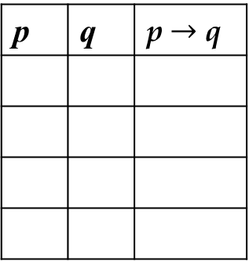
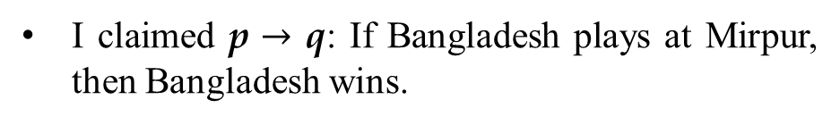
IMPLICATION
Truth Table
p: Bangladesh plays at Mirpur
p | q | p $→$ q
q: Bangladesh wins
F
F
T
I claimed p $→$ q: If Bangladesh plays at Mirpur, then Bangladesh wins.
F
T
T
T
F
F
In which of the cases, people can call me as a liar?
T
T
T
Bangladesh did not play at Mirpur, and so Bangladesh did not win.
No violation in my words.
Bangladesh did not play at Mirpur, but Bangladesh won.
No violation in my words.
Bangladesh played at Mirpur, but Bangladesh did not win.
Clear violation in my words.
Bangladesh played at Mirpur, and also they won.
No violation in my words.

Slide 28
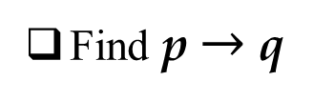
IMPLICATION
Consider the following two propositions
p: Sakib learns programming
q: He will get a good job
Find p $→$ q
If Sakib learns programming, he will get a good job
Sakib will get a good job when he learns programming
This proposition is false only when Sakib learns programming but he does not get a good job

Slide 29
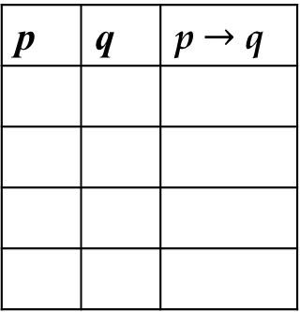
IMPLICATION
Consider the following two propositions
p: Sakib learns programming
q: The Sun rises in the East
Find p $→$ q
If Sakib learns programming, then the Sun rises in the East
This proposition is always true.
p | q | p $→$ q
When the conclusion is true, a proposition is always true
F
F
T
F
T
T
T
F
F
T
T
T

Slide 30
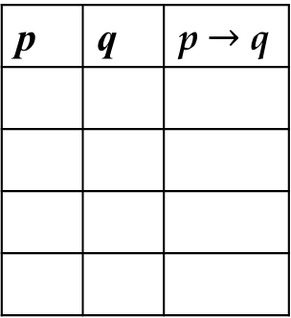
IMPLICATION
Consider the following two propositions
p: The Sun rises in the West
q: Bangladesh wins the match
Find p $→$ q
If the Sun rises in the West, then Bangladesh wins the match
This proposition is always true.
p | q | p $→$ q
When the hypothesis is false, a proposition is always true
F
F
T
F
T
T
T
F
F
T
T
T

Slide 31
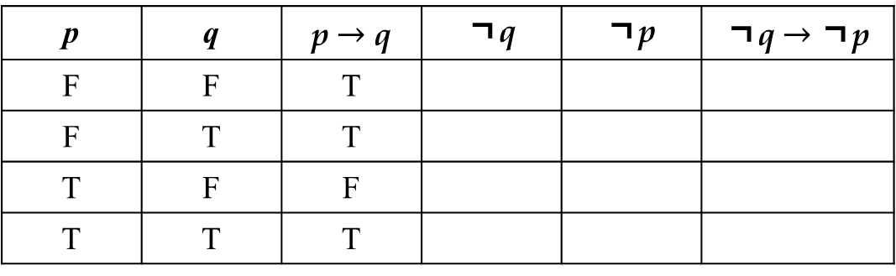
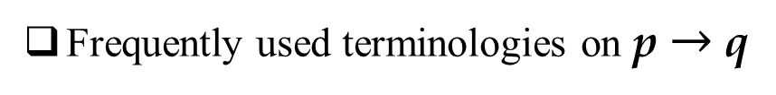

IMPLICATION
Frequently used terminologies on p $→$ q
Converse: q $→$ p is called the converse of p $→$ q.
Contrapositive: ㄱq $→$ ㄱp is called the contrapositive of p $→$ q.
Inverse: ㄱp $→$ ㄱq is called the inverse of p $→$ q.
Prove, the contrapositive of p $→$ q of has the same truth value as p $→$ q
p | q | p $→$ q | ㄱq | ㄱp | ㄱq $→$ ㄱp
F | F | T
F | T | T
T | F | F
T | T | T
T
T
T
F
T
T
T
F
F
F
F
T
p $→$ q ≡ㄱq $→$ ㄱp

Slide 32
IMPLICATION
Find the Converse, Contrapositive and Inverse of p $→$ q
p: Bangladesh plays at Mirpur
q: Bangladesh wins
Converse: If Bangladesh wins, then Bangladesh plays at Mirpur
Contrapositive: If Bangladesh does not win, then Bangladesh does not play at Mirpur
Inverse: If Bangladesh does not play at Mirpur, then Bangladesh does not win

Slide 33
BICONDITIONAL
Consider the following two propositions
p: Bangladesh plays at Mirpur
q: Bangladesh wins
p ↔ q implies a conditional statement: p if and only if q.
Bangladesh plays at Mirpur if and only if Bangladesh wins.
or
Bangladesh wins if and only if Bangladesh plays at Mirpur.
p ↔ q is true when both p $→$ q and q $→$ p are true.
Biconditional statements are sometimes called Bi-implications

Slide 34
BICONDITIONAL
Truth Table
p: Bangladesh plays at Mirpur
p | q | p↔ q
q: Bangladesh wins
F
F
T
I claimed p↔q: Bangladesh plays at Mirpur if and only if Bangladesh wins.
F
T
F
T
F
F
In which of the cases, people can call me as a liar?
T
T
T
Bangladesh did not play at Mirpur, and so Bangladesh did not win.
No violation in my words.
Bangladesh did not play at Mirpur, but Bangladesh won.
Clear violation in my words
Bangladesh played at Mirpur, but Bangladesh did not win.
Clear violation in my words.
Bangladesh played at Mirpur, and also they won.
No violation in my words.

Slide 35
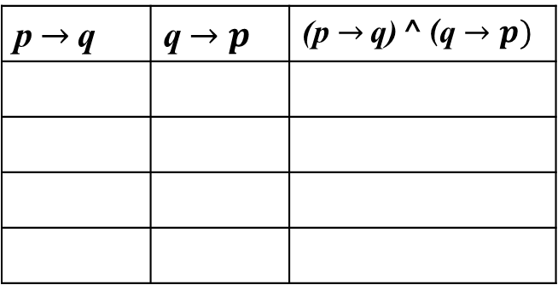

BICONDITIONAL
Statement: p ↔ q is true when both p $→$ q and q $→$ p are true.
Truth Table
p | q | p↔ q
p$→$q | q$→p$ | (p$→$q) ^ (q$→p)$
F
F
T
T
T
T
F
T
F
T
F
F
T
F
F
F
T
F
T
T
T
T
T
T
p ↔ q ≡ (p$→$q) ^ (q$→p)$

Slide 36
BICONDITIONAL
How to read?
p is necessary and sufficient for q.
q is necessary and sufficient for p.
if p then q, and conversely.
if q then p, and conversely.
p iff q.
q iff p.

Slide 37
PROPOSITIONAL EQUIVALENCES

Slide 38
TAUTOLOGY
Tautology
A compound proposition that is always true
No matter what the truth values of the propositions are
p ^{v} ㄱp is always a tautology
p | ㄱp | p ^{v} ㄱp
F | T | T
T | F | T

Slide 39
CONTRADICTION
Contradiction
A compound proposition that is always false
No matter what the truth values of the propositions are
p ^ ㄱp is always a contradiction
p | ㄱp | p ^ ㄱp
F | T | F
T | F | F

Slide 40
CONTINGENCY
Contingency
A compound proposition that is neither a tautology nor a contradiction

Slide 41
LOGICAL EQUIVALENCE
Compound propositions having same truth values in all possible cases are called logical equivalent
If two propositions p and q are logical equivalent then they are symbolized as p ≡ q
One way to prove the logical equivalence is truth table method
Logical equivalence can be proved using the laws of equivalences

Slide 42
LOGICAL EQUIVALENCE
Name of Law | Equivalence
Identity laws | p ^ T ≡ p
 | p ^{v} F ≡ p
Domination laws | p ^{v} T ≡ T
 | p ^ F ≡ F
Idempotent laws | p ^ p ≡ p
 | p ^{v} p ≡ p
Double negation law | ㄱ(ㄱp) ≡ p
Commutative laws | p ^{v} q ≡ q ^{v} p
 | p ^ q ≡ q ^ p
Associative laws | (p ^{v} q) ^{v} r ≡ p ^{v} (q ^{v} r)
 | (p ^ q) ^ r ≡ p ^ (q ^ r)

Slide 43
LOGICAL EQUIVALENCE
Name of Law | Equivalence
Distributive laws | p ^ (q ^{v} r) ≡ (p ^ q) ^{v} (p ^ r)
 | p ^{v} (q ^ r) ≡ (p ^{v} q) ^ (p ^{v} r)
De Morgan’s laws | ㄱ(p ^ q) ≡ ㄱp ^{v} ㄱq
 | ㄱ(p ^{v} q) ≡ ㄱp ^ ㄱq
Absorption laws | p ^{v} (p ^ q) ≡ p
 | p ^ (p ^{v} q) ≡ p
Negation law | p ^{v}ㄱp ≡T
 | p ^ㄱp ≡ F

Slide 44
OPERATOR PRECEDENCE
Parentheses is used to specify the precedence of operator
Operator | Precedence
ㄱ | 1
^ 🇻 | 2 3
→ ↔ | 4 5
(p 🇻 q) ^ (ㄱr)
p 🇻 q
ㄱr
(p 🇻 q) ^ (ㄱr)
Defining precedence is useful to reduce the number of parentheses
The proposition can be rewritten as: (p 🇻 q) ^ ㄱr
Rewrite the proposition without parentheses
p 🇻 q ^ ㄱr
Does the proposition remains same as previous?
No
ㄱr
q ^ ㄱr
p 🇻 (q ^ ㄱr)
To ignore any confusion, parentheses is used to specify order between conjunction-disjunction and implication-biconditional

Slide 45
DE MORGAN’s LAW
ㄱ(p ^ q) ≡ ㄱp ^{v} ㄱq
p
q
(p ^ q)
ㄱ(p ^ q)
ㄱ p
ㄱ q
ㄱp ^{v} ㄱq
F
F
F
T
T
T
T
F
T
F
T
T
F
T
T
F
F
T
F
T
T
T
T
T
F
F
F
F

Slide 46
DE MORGAN’s LAW
ㄱ(p ^{v} q) ≡ ㄱp ^ ㄱq
Prove by yourself

Slide 47
DE MORGAN’s LAW
De Morgan’s law is applicable for multiple propositional variables
ㄱ(p ^{v} q ^{v} r ^{v} s) ≡ ㄱp ^ ㄱq ^ ㄱr ^ ㄱs
ㄱ(p ^ q ^ r ^ s) ≡ ㄱp ^{v} ㄱq ^{v} ㄱr ^{v} ㄱs

Slide 48
CONDITIONAL DISJUNCTION EQUIVALENCE
p $→$ q ≡ ㄱp ^{v} q
Prove by yourself
Conversion of a conditional statement in to an unconditional statement

Slide 49
CONDITIONAL LOGICAL EQUIVALENCE
p → q ≡ ㄱp ^{v} q
(Conditional Disjunction Equivalence)
p → q ≡ ㄱq →ㄱ p
(Contrapositive)
ㄱ(p → ㄱ q) ≡ p ^ q
(De Morgan of Conditional Disjunction Equivalence)
(p → q) ^ (p → r) ≡ p → (q ^ r)
(p → r) ^ (q → r) ≡ (p ^{v} q) → r
(p → q) ^{v} (p → r) ≡ p → (q ^{v} r)
(p → r) ^{v} (q → r) ≡ (p ^ q) → r

Slide 50
CONDITIONAL LOGICAL EQUIVALENCE
(p → q) ^ (p → r) ≡ p → (q ^ r)
p: Bangladesh plays at Mirpur
q: Bangladesh wins
r: Shanto becomes Man of the Match
(p → q) ^ (p → r) becomes:
If Bangladesh plays at Mirpur then Bangladesh wins
and
If Bangladesh plays at Mirpur then Shanto becomes Man of the Match
p → (q ^ r) becomes:
If Bangladesh plays at Mirpur then Bangladesh wins and Shanto becomes Man of the Match

Slide 51
CONDITIONAL LOGICAL EQUIVALENCE
(p → q) ^ (p → r) ≡ p → (q ^ r)
(p → q) ^ (p → r)
≡ (ㄱp ^{v} q) ^ (ㄱp ^{v} r)
[Conditional disjunction equivalence]
≡ (ㄱp ^ ㄱp) ^{v} (ㄱp ^ r) ^{v} (q ^ ㄱp) ^{v} (q ^ r)
[Distributive law]
≡ ㄱp ^{v} (ㄱp ^ r) ^{v} (q ^ ㄱp) ^{v} (q ^ r)
[Idempotent law]
≡ ㄱp ^{v} (q ^ ㄱp) ^{v} (q ^ r)
[Absorption law]
[Absorption law]
≡ ㄱp ^{v} (q ^ r)
≡ p → (q ^ r)
[Conditional disjunction equivalence]

Slide 52
CONDITIONAL LOGICAL EQUIVALENCE
(p → r) ^ (q → r) ≡ (p ^{v} q) → r
p: Bangladesh plays at Mirpur
q: Bangladesh wins
r: Shanto becomes Man of the Match
(p → r) ^ (q → r) becomes:
If Bangladesh plays at Mirpur then Shanto becomes Man of the Match
and
If Bangladesh wins then Shanto becomes Man of the Match
(p ^{v} q) → r becomes:
If Bangladesh plays at Mirpur or Bangladesh wins then Shanto becomes Man of the Match

Slide 53
CONDITIONAL LOGICAL EQUIVALENCE
(p → r) ^ (q → r) ≡ (p ^{v} q) → r
(p → r) ^ (q → r)
≡ (ㄱp ^{v} r) ^ (ㄱq ^{v} r)
[Conditional disjunction equivalence]
≡ (ㄱp ^ ㄱq) ^{v} (ㄱp ^ r) ^{v} (r ^ ㄱq) ^{v} r
[Distributive and Idempotent law]
[De Morgan’s law and Absorption law]
≡ ㄱ(p ^{v} q) ^{v} r
≡ (p ^{v} q) → r
[Conditional disjunction equivalence]

Slide 54
CONDITIONAL LOGICAL EQUIVALENCE
(p → q) ^{v} (p → r) ≡ p → (q ^{v} r)
(p → r) ^{v} (q → r) ≡ (p ^ q) → r
Try it by yourself

Slide 55
BICONDITIONAL LOGICAL EQUIVALENCE
p ↔ q ≡ (p → q) ^ (q → p)
(Definition)
p ↔ q ≡ ㄱp ↔ ㄱq
p ↔ q ≡ (p ^ q) ^{v} (ㄱp ^ ㄱq)
(XNOR Equivalence)
p ↔ q ≡ p ↔ ㄱq

Slide 56
PRACTICE
ㄱ(p ^{v} (ㄱp ^ q)) ≡ ㄱp ^ ㄱq
ㄱ(p ^{v} (ㄱp ^ q))
≡ ㄱp ^ ㄱ(ㄱp ^ q)
[De Morgan’s Law]
≡ ㄱp ^ [ㄱ(ㄱp) ^{v} ㄱ q]
[De Morgan’s Law]
≡ ㄱp ^ (p ^{v} ㄱ q)
[Double Negation Law]
≡ (ㄱp ^ p) ^{v} (ㄱp ^ ㄱ q)
[Distribution Law]
≡ F ^{v} (ㄱp ^ ㄱ q)
[Negation Law]
≡ ㄱp ^ ㄱ q
[Identity Law]

Slide 57
PRACTICE
(p ^ q) → (p ^{v} q) is a tautology
(p ^ q) → (p ^{v} q)
≡ ㄱ(p ^ q) ^{v} (p ^{v} q)
[Conditional Disjunction Equivalence]
≡ (ㄱp ^{v} ㄱq) ^{v} (p ^{v} q)
[De Morgan’s Law]
≡ (ㄱp ^{v} p) ^{v} (ㄱq ^{v} q)
[Associative and Commutative Law]
[Negation Law]
≡ T ^{v} T
[Domination Law/Identity Law]
≡ T

Slide 58
PREDICATES and QUANTIFIERS

Slide 59
INTRODUCTION
Consider that there are n number of students S₁, S₂, S₃ … S_{n}
Let p be a proposition
p: All the students in the class know programming
How to determine the truth value of the statement p?
One way is to denote individual proposition for individual student
Let p_{i}: i^{th} student knows programming
p₁: S₁ knows programming
p₂: S₂ knows programming
p_{n}: S_{n} knows programming
So, p: p₁ ^ p₂ ^ p₃ ^ … ^ p_{n}
But this is a redundant expression
A better approach is to use variable based statements (Predicate logic)

Slide 60
PREDICATE
Consider the statement:
p: x is greater than 9
The statement is neither true, neither false
As a result, the statement can not be claimed as a proposition
But specifying a value of x turns the statement into a proposition
Let, x = 3 turns p in to a proposition that is false
This type of variable based sentences are handled in predicate logic
In p:
x is subject/ variable
“is greater than 9” is predicate
Variable based statements are written as propositional function
P(x): x is greater than 9
Assigning value of x turns the propositional function into a proposition
P(3): 3 is greater than 9
P(3) is a proposition

Slide 61
EXAMPLE
Consider the following propositional function:
Q(x, y): x = y + 3
Identify the truth value of Q(1, 0), Q(5, 2)
Q(1, 0): 1 = 0 + 3
False
Q(5, 2): 5 = 2 + 3
True

Slide 62
QUANTIFIERS
Consider the propositional function:
P(x): x is greater than 9
P(13) is a proposition and that is true
But is P(x) True for only x = 13?
NO
P(x) is True for all values of x over a domain D = {10, 11, 12, …, ∞}
“for all” quantified the predicate over D
In English, all, some, many, none, and few are used in quantifications
Let another domain is defined D’ = {5, 20, 6, 9, 12}
Quantify P(x) over the domain D’
P(x) is True for some values of x over D’

Slide 63
TYPES OF QUANTIFIERS
The Universal Quantifier
The Existential Quantifier

Slide 64
THE UNIVERSAL QUANTIFIERS
Mathematical statements that involves a property that is true for all values of a variable in a particular domain are expressed as universal quantifiers.
Let, P(x) be a statement/ propositional function
Write down the statement of universal quantification of P(x)
P(x) is true for all values of x in the domain
Notation of universal quantifier: ∀_{x}
Write down the universal quantification of P(x) with notation
∀_{x} P(x)
English terminologies:
for all
for every

Slide 65
EXAMPLE
Let Q(x) be the statement “x < 2.”
Find the truth value of the quantification: ∀_{x} Q(x)
The domain of x is R (all real values)
This statement is false
Because “x < 2” is not true for all real values of x
It is enough to prove that, if there exists a single value of x from R that does not satisfy Q(x), then the statement will be false
Q(3) be the proposition: 3 < 2
the statement is false
Clearly Q(x) is not true for all values of x in the described domain
It implies ∀_{x} Q(x) a false statement

Slide 66
EXAMPLE
Let Q(x) be the statement “x² < 10.”
Find the truth value of the quantification: ∀_{x} Q(x)
The domain of x consists of the positive integers not exceeding 3
The domain can be specified as {1, 2, 3}
The statement is true if Q(1) is true, Q(2) is true and Q(3) is true
So, here ∀_{x} Q(x) can be written as: Q(1) ^ Q(2) ^ Q(3)
Here all, Q(1), Q(2) and Q(3) are true and so ∀_{x} Q(x) is true
It implies that, the universal quantifier can be written as the conjunctional form of all the values of the variables in the domain
If the domain is specified as {x₁, x₂, x₃, …, x_{n}} then
∀_{x} Q(x) can be written as Q(x₁) ^ Q(x₂) ^ Q(x₃) … Q(x_{n})

Slide 67
COUNTEREXAMPLE
An element in the domain for which Q(x) is false is called a counterexample of ∀_{x} Q(x)
Let Q(x) be the statement “x² < 10.”
Find the counterexample of: ∀_{x} Q(x)
The domain of x consists of the positive integers not exceeding 4
The domain can be specified as {1, 2, 3, 4}
Q(1), Q(2) and Q(3) are true, but Q(4) is false
So, here x = 4 is a counterexample for ∀_{x} Q(x)

Slide 68
EXAMPLE
Let Q(x) be the statement “x² < 5”
Find the truth value of the quantification: ∃_{x} Q(x)
The domain of x consists of the positive integers not exceeding 3
The domain can be specified as {1, 2, 3}
The statement is true if there exists at least one x in the domain for which the statement “x² < 5” is true
Clearly, the statement is true for x = 1 and x = 2
Though the statement is false for x = 3 but still it is true
So, here ∃_{x} Q(x) can be written as: Q(1) ^{v} Q(2) ^{v} Q(3)
If the domain is specified as {x₁, x₂, x₃, …, x_{n}} then
∃_{x} Q(x) can be written as Q(x₁) ^{v} Q(x₂) ^{v} Q(x₃) … Q(x_{n})

Slide 69
UNIQUESNESS OF QUANTIFIERS
Notation: ∃! or ∃₁
∃!_{x} P(x) denotes: there is exactly one x such that P(x)
Let P(x) be the statement “x² < 40.”
Let Q(x) be the statement “x² < 5.”
Find the truth value of the quantification: ∃!_{x} P(x) and ∃!_{x} Q(x)
Domain consists of the positive even integers not exceeding 10
Domain can be specified as {2, 4, 6, 8, 10}
For ∃!_{x} P(x): P(2), P(4), P(6) are true. So ∃!_{x} P(x) is false
For ∃!_{x} Q(x): only P(2) is true. So ∃!_{x} Q(x) is true

Slide 70
PRECEDENCE OF QUANTIFIERS
Quantifiers have the highest priority among all the logical operators
How to read the following statement?
∀_{x} P(x) ^{v} Q(x)
The statement states the disjunction of and ∀_{x} P(x) and Q(x)
For better understanding, the statement can be parenthesized as:
(∀_{x} P(x)) ^{v} Q(x)
The task of quantifier to be completed first
The task of disjunction to be completed next

Slide 71
EQUIVALENCE OF QUANTIFIERS
Let P(x) and Q(x) be two propositional functions
A domain of x is specified as D = {x₁, x₂, x₃, …, x_{n}}
The logical equivalence of universal quantifiers denotes:
∀_{x} ( P(x) ^ Q(x) ) ≡ ∀_{x} P(x) ^ ∀_{x} Q(x)
It is known that:
∀_{x} P(x) ≡ P(x₁) ^ P(x₂) ^ … ^ P(x_{n})
∀_{x} Q(x) ≡ Q(x₁) ^ Q(x₂) ^…^ Q(x_{n})
Now, in L.H.S let, L(x) ≡ ( P(x) ^ Q(x) )
So the L.H.S. becomes: ∀_{x} L(x)
∀_{x} L(x) ≡ L(x₁) ^ L(x₂) ^ … ^ L(x_{n})
≡ ( P(x₁) ^ Q(x₁) ) ^ ( P(x₂) ^ Q(x₂) ) … ^ ( P(x_{n}) ^ Q(x_{n}) )
≡ ( P(x₁) ^ P(x₂) ^ … ^ P(x_{n}) ) ^ ( Q(x₁) ^ Q(x₂) ^…^ Q(x_{n}) )
≡ ∀_{x} P(x) ^ ∀_{x} Q(x)

Slide 72
EQUIVALENCE OF QUANTIFIERS
Let P(x) and Q(x) be two propositional functions
A domain of x is specified as D = {x₁, x₂, x₃, …, x_{n}}
The logical equivalence of existential quantifiers denotes:
∃_{x} ( P(x) ^{v} Q(x) ) ≡ ∃_{x} P(x) ^{v} ∃_{x} Q(x)
DO IT BY YOURSELF!

Slide 73
NEGATING UNIVERSAL QUANTIFIER
Statement: “Every student in the class is attentive”
The statement is a universal quantification: ∀_{x} P(x)
P(x): x is attentive
Domain of x: Every student in the class
The statement stands: For all x, x is attentive
How to claim the statement “Every student in the class is attentive” false?
At least one student in the class who is not attentive
There exists at least one x, x is not attentive
∃_{x} ㄱP(x)
ㄱ ∀_{x} P(x) ≡ ∃_{x} ㄱP(x)

Slide 74
NEGATING EXISTENTIAL QUANTIFIER
Statement: “At least one student in the class is attentive”
The statement is an existential quantification: ∃_{x} P(x)
P(x): x is attentive
Domain of x: Every student in the class
The statement stands: For all x, x is attentive
How to claim the statement “At least one student in the class is attentive” false?
Every student in the class is sleepy (not attentive)
For all x, x is not attentive
∀_{x} ㄱP(x)
ㄱ ∃_{x} P(x) ≡ ∀_{x}ㄱP(x)

Slide 75
De MORGAN FOR QUANTIFIERS
ㄱ ∀_{x} P(x) ≡ ∃_{x} ㄱP(x)
ㄱ ∃_{x} P(x) ≡ ∀_{x}ㄱP(x)
ㄱ ∀_{x} P(x)
≡ ㄱ ( P(x₁) ^ P(x₂) ^ … ^ P(x_{n}) )
≡ ㄱP(x₁) ^{v} ㄱP(x₂) ^{v} … ^{v} ㄱP(x_{n})
[De Morgan’s Law]
≡ ∃_{x}ㄱP(x)
[Basic property of quantifier]
ㄱ ∃_{x} P(x)
Do it by yourself

Slide 76
PRACTICE
Find the negations of the statements.
∀_{x} (x² > x)
Ans: ∃_{x} (x² ≤ x)
∃_{x} (x² = 2)
Ans: ∀ _{x} (x² ≠ 2)

Slide 77
PRACTICE
Show that, ㄱ ∀_{x} (P(x) → Q(x)) ≡ ∃x (P(x) ^ㄱQ(x))
ㄱ ∀_{x} (P(x) → Q(x))
≡ ㄱ ∀_{x} (ㄱ P(x) ^{v} Q(x) )
[Conditional Disjunction]
≡ ∃_{x} ㄱ (ㄱ P(x) ^{v} Q(x) )
[Universal to existential]
≡ ∃_{x} ( P(x) ^ ㄱQ(x) )
[De Morgan’s law]

Slide 78
NESTED QUANTIFIERS

Slide 79
INTRODUCTION
When one quantifier is used in the scope of another quantifier
∀_{x} ∃_{y} P(x, y)
For all x, there exists an y such that P(x, y) is true
The operation can be treated as the following:
∀_{x} Q(x)
where, Q(x) ≡ ∃_{y} P(x, y)

Slide 80
PRACTICE
Propositional function: P(x, y): x-y attracts
Domain of x and y is pole of magnet, D = {North, South}
Find the truth values of the following quantifications
∀_{x} ∀_{y} P(x, y)
∀_{x} ∃_{y} P(x, y)
∃_{y} ∀_{x} P(x, y)
∃_{x} ∃_{y} P(x, y)

Slide 81
PRACTICE (Cont..)
P(x, y): x-y attracts
∀_{x} ∀_{y} P(x, y)
D = {North, South}
For all x and for all y, P(x, y) is true
North-North attracts
❌
North-South attracts
✓
South-North attracts
✓
South-South attracts
❌
For all combination of x, all combination of y does not match
Hence, ∀_{x} ∀_{y} P(x, y) is false

Slide 82
PRACTICE (Cont..)
P(x, y): x-y attracts
∀_{x} ∃_{y} P(x, y)
D = {North, South}
For all x there exists a y such that P(x, y) is true
North-North attracts
North-South attracts
✓
South-North attracts
✓
South-South attracts
For both x = North and South, there exists a member from y to attract
Hence, ∀_{x} ∃_{y} P(x, y) is true

Slide 83
PRACTICE (Cont..)
P(x, y): x-y attracts
∃_{y} ∀_{x} P(x, y)
D = {North, South}
There exists a y such that, for all x P(x, y) is true
North-North attracts
❌
North-South attracts
✓
South-North attracts
✓
South-South attracts
❌
There exists no y, for which both x = North and South attracts
Hence, ∃_{y} ∀_{x} P(x, y) is false

Slide 84
PRACTICE (Cont..)
P(x, y): x-y attracts
∃_{x} ∃_{y} P(x, y)
D = {North, South}
There exists a x for which there is a y such that, P(x, y) is true
North-North attracts
North-South attracts
✓
South-North attracts
South-South attracts
There exists a y = North, for there is a x = South that attracts
Hence, ∃_{x} ∃_{y} P(x, y) is true

Slide 85
PRACTICE (Cont..)
Find the truth value of the following quantifications
∀_{x} ∀_{y} ∃_{z} (x + y = z)
True
∃_{z} ∀_{x} ∀_{y} (x + y = z)
False
Domain: R
Try by yourself

Slide 86
PRACTICE (Cont..)
Translate in to English statement
∀_{x} ∀_{y} ( (x > 0) ^ (y < 0) → (xy < 0) )
Domain = R
Ans:
For every real number x and y,
if x > 0 and y < 0,
then xy < 0

Slide 87
PRACTICE (Cont..)
Translate in to English statement
∀_{x} ( C(x) ^{v} ∃_{y} ( C(y) ^ F(x, y) ) )
C(x) : x has a computer
F(x, y) : x and y are friends
Domain of both x and y consists of all students in your university
Ans:
For every student x and y in your university,
x has a computer
or
there is a student y such that y has a computer
and
x and y are friends
In summary:
Every student in your university, has a computer or has a friend who has a computer

Slide 88
NEGATING NESTED QUANTIFIERS
Find the negation of the following statement:
∀_{x} ∃_{y} ( xy = 1 )
Let Q(x, y): ∃_{y} ( xy = 1 )
So, the given statement stands: ∀_{x} Q(x, y)
The negation of the statement is: ㄱ∀_{x} Q(x, y)
Applying De Morgan’s law: ∃_{x}ㄱQ(x, y)
Replacing Q(x, y) with ∃_{y} ( xy = 1 ) : ∃_{x}ㄱ( ∃_{y} ( xy = 1 ) )
Applying De Morgan’s law: ∃_{x} ∀_{y}ㄱ( xy = 1 )
Applying the negation of xy = 1: ∃_{x} ∀_{y}ㄱ( xy ≠ 1 )

Slide 89
RULES OF INFERENCE

Slide 90
ARGUMENT
Transform rules which are used to infer a conclusion from a premise to create an argument
Let, p, q are two propositions
If p ^{v} q is true
Also p is false
The it can be surely claimed that, q is true
This can be written as the following
p ^{v} q is true
p ^{v} q
ㄱp is true
ㄱp
Argument
∴ q is true
∴ q
Valid Argument

Slide 91
ARGUMENT
Let, p, q are two propositions
Is the following argument a valid one?
p ^{v} q
Invalid argument
p
∴ q
Here, the claim is that,
If p ^{v} q is true
And p is true
Then q is also true
But in case of disjunction if p ^{v} q is true, then it can not surely claimed that q is true
So the argument is not valid

Slide 92
ARGUMENT EXPRESSION
Let, p, q are two propositions
p ^{v} q
ㄱp
∴ q
What does this argument means?
If p ^{v} q is true and ㄱp is true, then q is true
(p ^{v} q) ^ ㄱp → q
is a tautology
because this argument is always true

Slide 93
RULES OF INFERENCE
Let, p, q are two propositions
p ^{v} q
ㄱp
∴ q
What does this argument means?
If p ^{v} q is true and ㄱp is true, then q is true
(p ^{v} q) ^ ㄱp → q
is a tautology
because this argument is always true
Premise/ Hypothesis
Conclusion

Slide 94
RULES OF INFERENCE
Rule
Tautology
Name of Rule
p → q
p
( (p → q) ^ p) → q
Modus Ponens
∴ q
p → q
ㄱq
( (p → q) ^ ㄱq) → ㄱp
Modus Tollens
∴ ㄱp
p → q
q → r
( (p →q) ^ (q →r) )→(p → r)
Hypothetical Syllogism
∴ p → r
p ^{v} q
Disjunctive Syllogism
ㄱp
( (p ^{v} q) ^ ㄱp) → q
∴ q

Slide 95
RULES OF INFERENCE
Rule
Tautology
Name of Rule
p
∴ p ^{v} q
p → (p ^{v} q)
Addition
p ^ q
(p ^ q) → p
∴ p
Simplification
(p ^ q) → q
∴ q
p
q
( p ^ q )→( p ^ q )
Conjunction
∴ p ^ q
p ^{v} q
ㄱp ^{v} r
( (p ^{v} q) ^ (ㄱp ^{v} r) ) → (q ^{v} r)
Resolution
∴ q ^{v} r

Slide 96
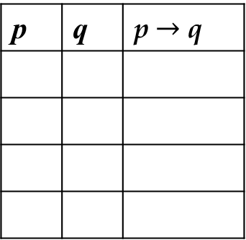
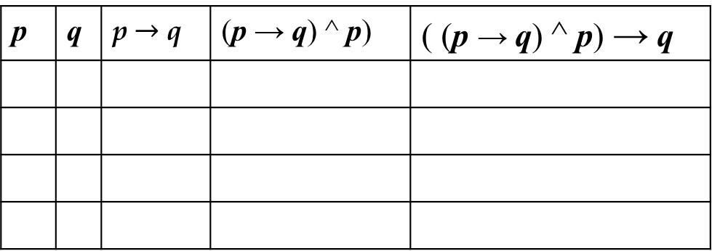
MODUS PONENS
Let, p, q are two propositions
p: Bangladesh plays at Mirpur
q: Bangladesh wins
states that,
p → q
If Bangladesh plays at Mirpur then Bangladesh wins is true
p
And Bangladesh plays at Mirpur is true
∴ q
Then definitely, Bangladesh wins is true
Tautology: ( (p → q) ^ p) → q
p | q | p $→$ q
p | q | p $→$ q | (p → q) ^ p) | ( (p → q) ^ p) → q
F
F
T
F
F
T
F
T
F
T
T
F
T
T
F
T
T
F
F
T
F
F
F
T
T
T
T
T
T
T
T
T

Slide 97
HYPOTHETICAL SYLLOGISM
Let, p, q are two propositions
p: Bangladesh plays at Mirpur
q: Bangladesh wins
r: Shanto becomes Man of the Match
p → q
q → r
∴ p → r
states that,
If Bangladesh plays at Mirpur then Bangladesh wins is true
And If Bangladesh wins then Shanto becomes Man of the Match is true
Then definitely, if Bangladesh plays at Mirpur then Shanto becomes Man of the Match is true
Tautology: ( (p →q) ^ (q →r) ) → (p → r)

Slide 98
EXERCISE-1
Show that the premises “It is not sunny this afternoon and
it is colder than yesterday,” “We will go swimming only if it is sunny,” “If we do not go swimming, then we will go for a trip,” and “If we go for a trip, then we will be home by sunset” lead to the conclusion “We will be home by sunset.”
p: It is sunny this afternoon
q: It is colder than yesterday
r: We will go swimming
s: We will go for a trip
t: We will be home by sunset
1. ㄱp ^ q
[Premise]
2. r → p
[Premise]
3. ㄱr → s
[Premise]
4. s → t
[Premise]

Slide 99
EXERCISE-1
1. ㄱp ^ q
[Premise]
2. r → p
[Premise]
3. ㄱr → s
[Premise]
4. s → t
[Premise]
5. ㄱp
[Simplification using (1)]
6. ㄱr
[Modus Tollens using (2) and (5)]
7. s
[Modus Ponens using (3) and (6)]
8. t
[Modus Ponens using (4) and (7)]

Slide 100
EXERCISE-2
Show that the premise p ^ ( p → q ) leads to the conclusion q
1. p ^ ( p → q )
[Premise]
2. p → q
[Simplification using (1)]
3. p
[Simplification using (1)]
4. q
[Modus Ponens using (2) and (3)]

Slide 101
EXERCISE-3
Consider the following premises
p → ( m ^{v} e )
s → ㄱ e
s ^ p
Show that the premises lead to the conclusion m
1. p → ( m ^{v} e )
[Premise]
2. s → ㄱ e
[Premise]
3. s ^ p
[Premise]
4. p
[Simplification using (3)]
5. s
[Simplification using (3)]
6. ㄱ e
[Modus Ponens using (2) and (5)]
7. m ^{v} e
[Modus Ponens using (1) and (4)]
8. e
[Disjunctive Syllogism using (6) and (7)]

Slide 102
EXERCISE-4
Consider the following premises
p
p → q
q → ㄱ r
Show that the premises lead to the conclusion ㄱr
1. p
[Premise]
2. p → q
[Premise]
3. q → ㄱ r
[Premise]
4. q
[Modus Ponens using (1) and (2)]
5. ㄱ r
[Modus Ponens using (3) and (4)]
Or,
4. p → ㄱ r
[Hypothetical Syllogism using (2) and (3)]
5. ㄱ r
[Modus Ponens using (1) and (4)]

Slide 103
RULES OF INFERENCE FOR QUANTIFIERS
Rule of Inference | Name
∀_{x} P(x)
Universal instantiation
∴ P(c)
P(c) for an arbitrary c
Universal generalization
∴∀_{x} P(x)
∃ _{x} P(x)
∴ P(c) for some element c
Existential instantiation
P(c) for some element c
Existential generalization
∴ ∃ _{x} P(x)

Slide 104
UNIVERSAL INSTANTIATION
If c is an arbitrary element in the domain of x
∀_{x} P(x)
∴ P(c)
Let, P(x): x knows programming
Domain of x: Students in the class
c: Any arbitrary student in the class
The claim is, ∀_{x} P(x): Every students in the class knows programming
Therefore, c definitely knows programming

Slide 105
UNIVERSAL INSTANTIATION
If c is an arbitrary element in the domain of x
∀_{x} P(x)
∴ P(c)
Let, P(x): x knows programming
Domain of x: Students in the class
c: Any arbitrary student in the class
The claim is, ∀_{x} P(x): Every students in the class knows programming
Therefore, c definitely knows programming

Slide 106
UNIVERSAL GENERALIZATION
If c is an arbitrary element in the domain of x
P(c) for an arbitrary c
∴∀_{x} P(x)
Let, P(x): x knows programming
Domain of x: Students in the class
c: Any arbitrary student in the class
The claim is, P(c): Any arbitrary student in the class knows programming
Therefore, every student in the class knows programming

Slide 107
EXISTENTIAL INSTANTIATION
If c is an arbitrary element in the domain of x
∃ _{x} P(x)
∴ P(c) for some element c
Let, P(x): x knows programming
Domain of x: Students in the class
c: Some student in the class
The claim is, ∃_{x} P(x): Some students in the class know programming
Therefore, c denotes some students where P(c) states they know programming

Slide 108
EXISTENTIAL GENERALIZATION
SELF STUDY

Slide 109
EXERCISE
Consider the following premises
∃ _{x} (C(x) ^ ㄱB(x))
∀_{x} (C(x) → P(x))
Show that the premises lead to the conclusion ∃ _{x} (P(x) ^ ㄱB(x))
1. ∃ _{x} (C(x) ^ ㄱB(x))
[Premise]
2. ∀_{x} (C(x) → P(x))
[Premise]
3. C(a) ^ ㄱB(a)
[Existential instantiation from (1)]
4. C(a)
[Simplification using (3)]
5. C(a) → P(a)
[Universal instantiation from (2)]
6. P(a)
[Modus ponens using (4) and (5)]
7. ㄱ B(a)
[Simplification using (3)]
8. P(a) ^ ㄱ B(a)
[Conjunction using (6) and (7)]
9. ∃ _{x} (C(x) ^ ㄱB(x))
[Existential Generalization from (8)]

Slide 110
EXERCISE
Consider the following premises
∀_{x} (P(x) ^{v} Q(x))
∀_{x} (ㄱQ(x) ^{v} S(x))
∃_{x} (ㄱP(x))
∀_{x} (R(x) → ㄱS(x))
Show that the premises lead to the conclusion ∃ _{x} (ㄱR(x))
P ^ Q ^{v} R
R → S
Show that the premises lead to the conclusion P ^{v} S

Slide 111
EXERCISE
Consider the following premises
P ^ Q ^{v} R
R → S
Show that the premises lead to the conclusion P ^{v} S

Slide 112
PROOF TECHNIQUES

Slide 113
TERMINOLOGIES
Theorem
A statement that can be shown true
The term is considered at least somewhat important
Axioms/ Postulates
The statements used in proofs that are assured to be true
Lemma
Less important theorem that is used in the proof of other results
Corollary
A theorem that can be established directly from a proved theorem

Slide 114
TERMINOLOGIES
Theorem
A statement that can be shown true
The term is considered at least somewhat important
Axioms/ Postulates
The statements used in proofs that are assured to be true
Lemma
Less important theorem that is used in the proof of other results
Corollary
A theorem that can be established directly from a proved theorem

Slide 115
EXPRESSION OF THEOREM
A theorem can be stated as ∀x (P(x) → Q(x))
If a set of statements P is true for all values in a domain
Then it lead to a conclusion to be true for all values in that domain
Pythagorean Theorem
For all Right-triangle, sum of squares of based and height equals to the square of the hypotenuse
Let, P(x): x is right-angled
Let, Q(x): c_{x}² = a_{x}² + b_{x}²
Domain of x: Set of Triangles
The theorem can be written as: ∀x (P(x) → Q(x))

Slide 116
PROOF TECHNIQUES
Direct Proof
Proof by Contraposition
Proof by Contradiction

Slide 117
DIRECT PROOF
A conditional statement p → q is constructed
After that, p → q is validated by showing that:
If p is true
Then q must be true
So that, the p true and q false condition never occurs
In direct proof:
Initial assumption is p true
Then axioms, definitions, previously proved theorems with rules of inferences are used to lead q is true

Slide 118
DIRECT PROOF
If n is an odd integer, then n² is odd.
P(n): n is an odd integer
Q(n): n² is odd
The theorem states: ∀n (P(n) → Q(n)) [Domain of n is integers]
According to Direct proof, the initial assumption is: P(n) true
According to initial assumption, let n = 2k + 1 [k is some integers]
So, n² = (2k + 1)²
So, n² = 4k² + 4k + 1
So, n² = 2(2k² + 2k) + 1
So, n² = 2m + 1 [m = 2k² + 2k]
n² is odd
So, according to the initial assumption, Q(n) is proved to be true
So, P(n) → Q(n) is true

Slide 119
DIRECT PROOF
If n is an even integer, then n² is even.
P(n): n is an even integer
Q(n): n² is even
The theorem states: ∀n (P(n) → Q(n)) [Domain of n is integers]
According to Direct proof, the initial assumption is: P(n) true
According to initial assumption, let n = 2k [k is some integers]
So, n² = (2k)²
So, n² = 4k²
So, n² = 2(2k)
n² is even
So, according to the initial assumption, Q(n) is proved to be true
So, P(n) → Q(n) is true

Slide 120
PROOF BY CONTRAPOSITION
Direct proof starts from the premise that often may lead to dead end
Proof by contraposition make use of the fact that
p → q is equivalent to its contrapositive statement ㄱq → ㄱp
In direct proof:
Initial assumption is ㄱq is true
Then axioms, definitions, previously proved theorems with rules of inferences are used to lead ㄱp is true

Slide 121

PROOF BY CONTRAPOSITION
If n² is an even integer, then n is even.
P(n): n² is an even integer
Q(n): n is even
The theorem states: ∀n (P(n) → Q(n)) [Domain of n is integers]
According to Direct proof, the initial assumption is: P(n) true
According to initial assumption, let n² = 2k [k is some integers]
So, n = $\sqrt{2k}$
But this is not sufficient to prove that, n is even
Here, the proof by Contraposition can be used

Slide 122
PROOF BY CONTRAPOSITION
If n² is an even integer, then n is even.
P(n): n² is an even integer
Q(n): n is even
The theorem states: ∀n (P(n) → Q(n)) [Domain of n is integers]
According to proof by contraposition,
ㄱP(n): n² is an odd integer
ㄱQ(n): n is odd
The theorem states: ∀n (ㄱQ(n) → ㄱP(n))
According to initial assumption, let n is odd: n = 2k + 1
So, n² = (2k + 1)²
So, n² = 4k² + 4k + 1
So, n² = 2(2k² + 2k) + 1
So, n² = 2m + 1 [m = 2k² + 2k]
n² is odd
According to the assumption:ㄱQ(n), ㄱP(n) is proved to be true
So, the theorem is proved by contraposition

Slide 123
PROOF BY CONTRAPOSITION
For all integers n if 3n + 2 is odd, then n is odd.
DO IT YOURSELF

Slide 124
PROOF BY CONTRAPOSITION
If n = ab, where a and b are positive integers, then a ≤ $\sqrt{n}$ or b ≤ $\sqrt{n}$
DO IT YOURSELF

Slide 125
THANK YOU!
ANY QUESTIONS?

